Slide 1
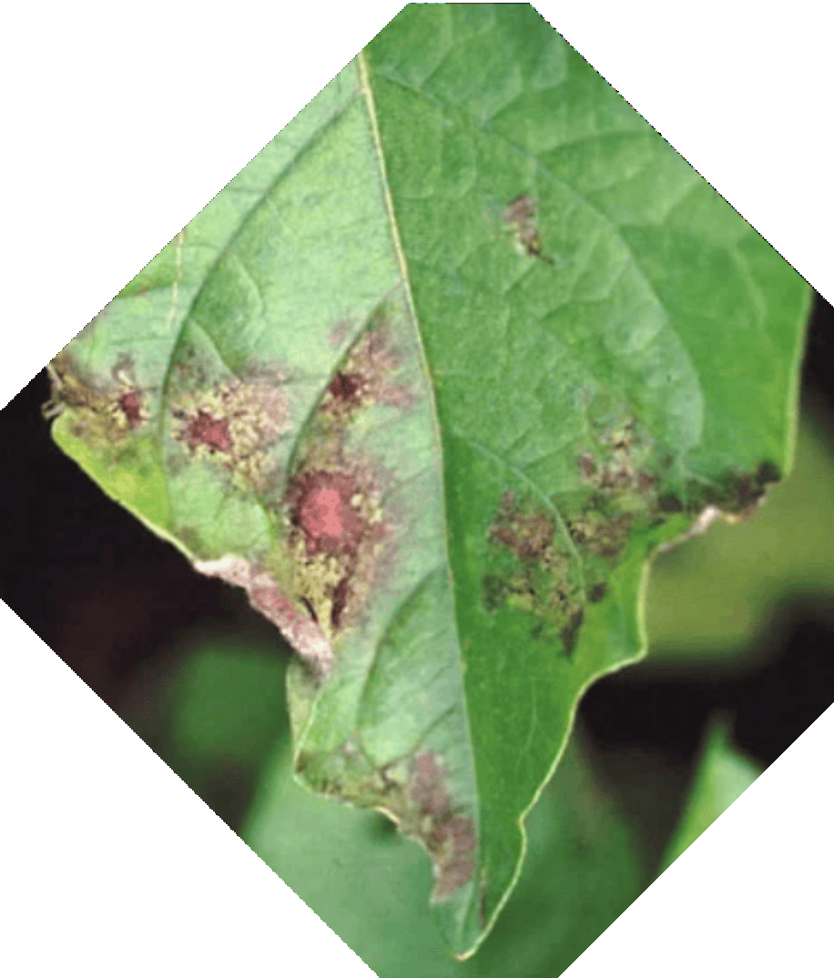

Plant Disease Detection
Minor Project - 18CSP107L
PROJECT GUIDE: MRS PRIYA S
AKSH KALYANI RA2011003010525 NIPUN CHAURASIA RA2011003010536

Slide 2
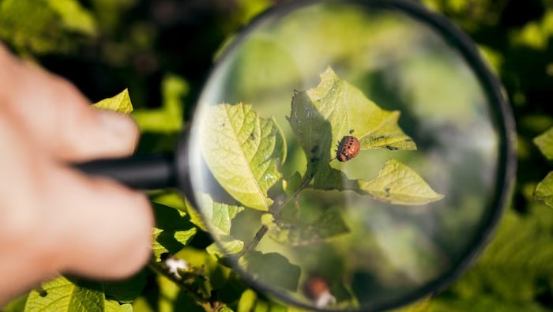
Abstract
One of the important and tedious task in agricultural practices is detection of disease on crops. It requires huge time as well as skilled labor. This paper proposes a smart and efﬁcient technique for detection of crop disease which uses computer vision and machine learning techniques. The proposed system is able to detect 20 different diseases of 5 common plants with 93% accuracy

Slide 3

Introduction
Plant diseases can cause signiﬁcant damage to crops, leading to economic losses and food security issues. Machine learning techniques have shown great potential in plant disease detection, enabling early diagnosis and effective management. This project aims to explore advanced machine learning algorithms and their applications in plant disease detection using ML and AI.

Slide 4
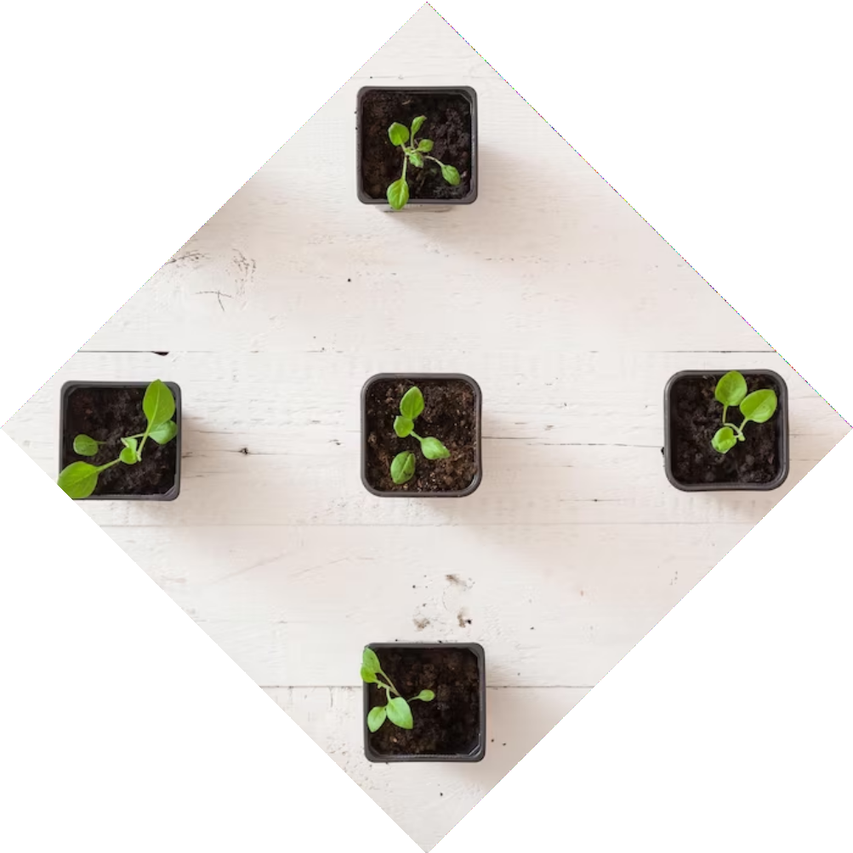
Motivation
In the diverse and vibrant landscapes of India, agriculture has been the backbone of the nation's economy for centuries. However, the persistent threat of plant diseases continues to challenge the livelihoods of millions of farmers across the country. It is in this context that our project, focused on Plant Disease Identiﬁcation using Machine Learning (ML) and Deep Learning, takes center stage.

Slide 5
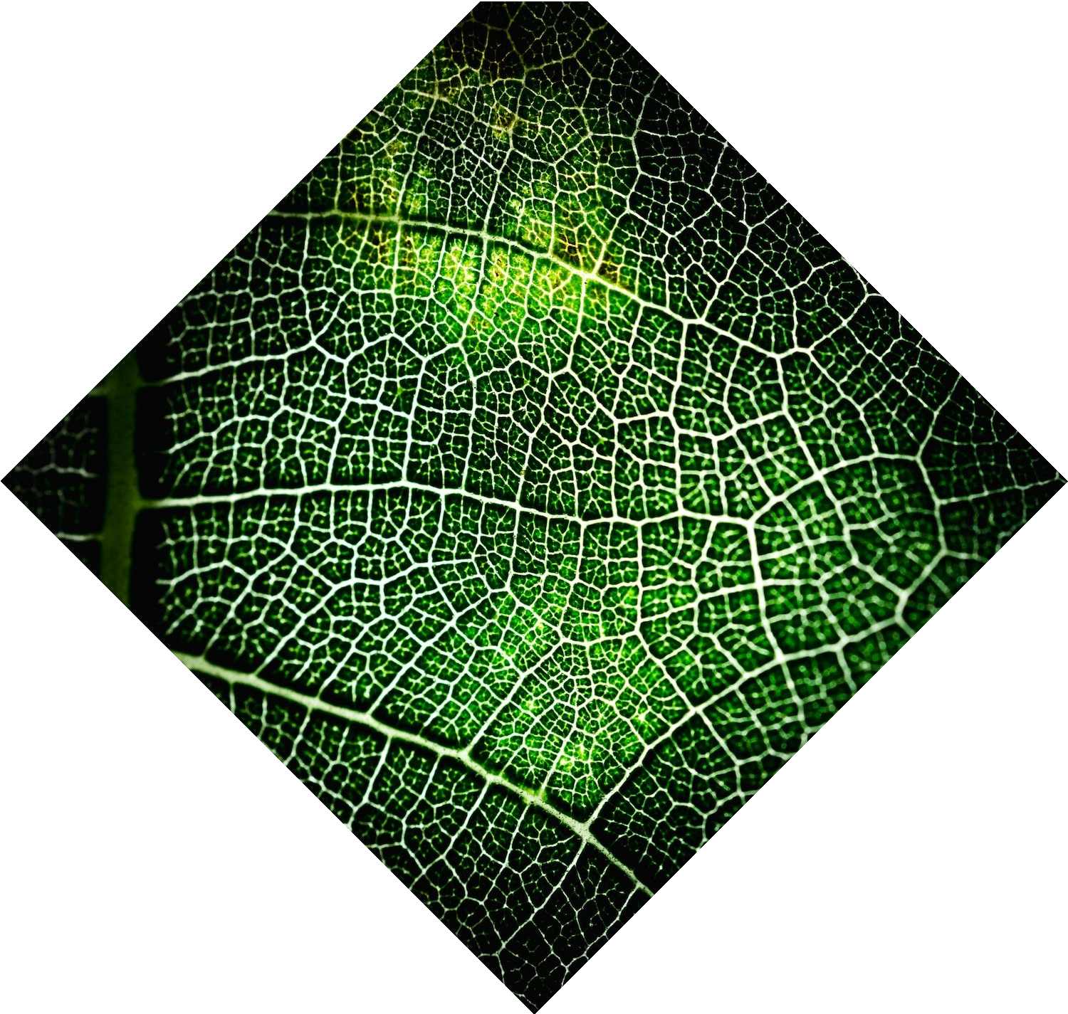
Scope
Data Collection and Annotation
Algorithm development
Disease Detection
Model Training and Validation

Slide 6


Objective
The primary objective of our Plant Disease Identiﬁcation project is to develop a robust and efﬁcient-AI-powered system that revolutionizes the detection and management of plant diseases.

Slide 7
Refernces
New Plant Diseases DatasetImage dataset containing different healthy and unhealthy crop leaves. - Kaggle
PlantDoc:ADatasetforVisualPlantDiseaseDetection - IIT Gujarat
Plant disease detection using CNN - IIT Gandhinagar

Slide 8
Thank You !

